Slide 1
Cloud Security and Privacy

Slide 2
What is Privacy?
The concept of privacy varies widely among (and sometimes within) countries, cultures, and jurisdictions.
It is shaped by public expectations and legal interpretations; as such, a concise definition is elusive if not impossible.
Privacy rights or obligations are related to the collection, use, disclosure, storage, and destruction of personal data (or Personally Identifiable Information—PII).
At the end of the day, privacy is about the accountability of organizations to data subjects, as well as the transparency to an organization’s practice around personal information.
From [6] Cloud Security and Privacy by Mather and Kumaraswamy

Slide 3
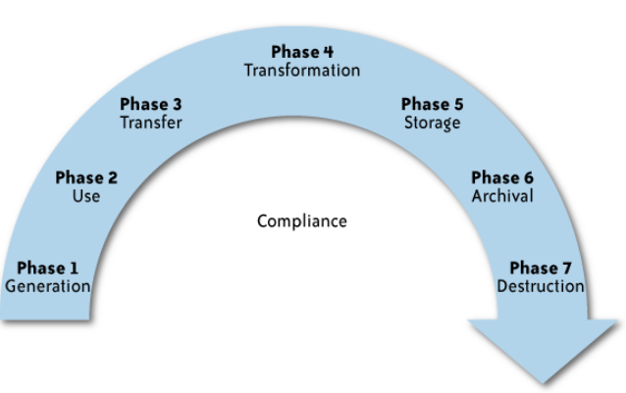
What is the data life cycle?
Personal information should be managed as part of the data used by the organization
Protection of personal information should consider the impact of the cloud on each phase
From [6] Cloud Security and Privacy by Mather and Kumaraswamy

Slide 4
What Are the Key Privacy Concerns?
Typically mix security and privacy
Some considerations to be aware of:
Storage
Retention
Destruction
Auditing, monitoring and risk management
Privacy breaches
Who is responsible for protecting privacy?
From [6] Cloud Security and Privacy by Mather and Kumaraswamy

Slide 5
Storage
Is it commingled with information from other organizations that use the same CSP?
The aggregation of data raises new privacy issues
Some governments may decide to search through data without necessarily notifying the data owner, depending on where the data resides
Whether the cloud provider itself has any right to see and access customer data?
Some services today track user behaviour for a range of purposes, from sending targeted advertising to improving services
From [6] Cloud Security and Privacy by Mather and Kumaraswamy

Slide 6
Retention
How long is personal information (that is transferred to the cloud) retained?
Which retention policy governs the data?
Does the organization own the data, or the CSP?
Who enforces the retention policy in the cloud, and how are exceptions to this policy (such as litigation holds) managed?
From [6] Cloud Security and Privacy by Mather and Kumaraswamy

Slide 7
Destruction
How does the cloud provider destroy PII at the end of the retention period?
How do organizations ensure that their PII is destroyed by the CSP at the right point and is not available to other cloud users?
Cloud storage providers usually replicate the data across multiple systems and sites—increased availability is one of the benefits they provide.
How do you know that the CSP didn’t retain additional copies?
Did the CSP really destroy the data, or just make it inaccessible to the organization?
Is the CSP keeping the information longer than necessary so that it can mine the data for its own use?
From [6] Cloud Security and Privacy by Mather and Kumaraswamy

Slide 8
Auditing, monitoring and risk management
How can organizations monitor their CSP and provide assurance to relevant stakeholders that privacy requirements are met when their PII is in the cloud?
Are they regularly audited?
What happens in the event of an incident?
If business-critical processes are migrated to a cloud computing model, internal security processes need to evolve to allow multiple cloud providers to participate in those processes, as needed.
These include processes such as security monitoring, auditing, forensics, incident response, and business continuity
From [6] Cloud Security and Privacy by Mather and Kumaraswamy

Slide 9
Privacy breaches
How do you know that a breach has occurred?
How do you ensure that the CSP notifies you when a breach occurs?
Who is responsible for managing the breach notification process (and costs associated with the process)?
If contracts include liability for breaches resulting from negligence of the CSP?
How is the contract enforced?
How is it determined who is at fault?
From [6] Cloud Security and Privacy by Mather and Kumaraswamy

Slide 10
Who is responsible for protecting privacy?
e.g., Suppose a hacker breaks into Cloud Provider A and steals data from Company X.
Assume that the compromised server also contained data from Companies Y and Z.
Who investigates this crime?
Is it the Cloud Provider, even though Company X may fear that
the provider will try to absolve itself from responsibility?
Is it Company X and, if so, does it have the right to see other data on that server,
including logs that may show access to the data of Companies Y and Z?
Data breaches have a cascading effect
Full reliance on a third party to protect personal data?
In-depth understanding of responsible data stewardship
Organizations can transfer liability, but not accountability
Risk assessment and mitigation throughout the data life cycle is critical.
Many new risks and unknowns
The overall complexity of privacy protection in the cloud represents a bigger challenge.
From [6] Cloud Security and Privacy by Mather and Kumaraswamy

Slide 11
Part III. Possible Solutions
Minimize Lack of Trust
Policy Language
Certification
Minimize Loss of Control
Monitoring
Utilizing different clouds
Access control management
Identity Management (IDM)
Minimize Multi-tenancy

Slide 12
Security Issues in the Cloud
In theory, minimizing any of the issues would help:
Third Party Cloud Computing
Loss of Control
Take back control
Data and apps may still need to be on the cloud
But can they be managed in some way by the consumer?
Lack of trust
Increase trust (mechanisms)
Technology
Policy, regulation
Contracts (incentives): topic of a future talk
Multi-tenancy
Private cloud
Takes away the reasons to use a cloud in the first place
VPC: its still not a separate system
Strong separation
Notes:
While VPC providers argue that they provide superior isolation, the fact of the matter is that your data is not a separate physical system: your data is still stored on actual servers along with other consumers’ data, but logically separated. If the actual server fails, your data and applications stored on it are lost. Also, there needs to be a high level of trust as to the degree of isolation provided.

Slide 13
Third Party Cloud Computing
Like Amazon’s EC2, Microsoft’s Azure
Allow users to instantiate Virtual Machines
Allow users to purchase required quantity when required
Allow service providers to maximize the utilization of sunk capital costs
Confidentiality is very important

Slide 14
Known issues: Already exist
Confidentiality issues
Malicious behavior by cloud provider
Known risks exist in any industry practicing outsourcing
Provider and its infrastructure needs to be trusted

Slide 15
New Vulnerabilities & Attacks
Threats arise from other consumers
Due to the subtleties of how physical resources can be transparently shared between VMs
Such attacks are based on placement and extraction
A customer VM and its adversary can be assigned to the same physical server
Adversary can penetrate the VM and violate customer confidentiality

Slide 16
More on attacks…
Collaborative attacks
Mapping of internal cloud infrastructure
Identifying likely residence of a target VM
Instantiating new VMs until one gets co-resident with the target
Cross-VM side-channel attacks
Extract information from target VM on the same machine

Slide 17
More on attacks…
Can one determine where in the cloud infrastructure an instance is located?
Can one easily determine if two instances are co-resident on the same physical machine?
Can an adversary launch instances that will be co-resident with other user instances?
Can an adversary exploit cross-VM information leakage once co-resident?
Answer: Yes to all

Slide 18
- POLICY LANGUAGE - CERTIFICATION
Minimize Lack of Trust

Slide 19
Minimize Lack of Trust: Policy Language
Consumers have specific security needs but don’t have a say-so in how they are handled
What the heck is the provider doing for me?
Currently consumers cannot dictate their requirements to the provider (SLAs are one-sided)
Standard language to convey one’s policies and expectations
Agreed upon and upheld by both parties
Standard language for representing SLAs
Can be used in a intra-cloud environment to realize overarching security posture
Notes:
These SLAs typically state the high level policies of the provider (e.g. Will maintain uptime of 98%) and do not allow cloud consumers to dictate their requirements to the provider. COI clouds in particular have specific security policy requirements that must be met by the provider, due to the nature of COIs and the missions they are used for. These requirements need to be communicated to the provider and the provider needs to provide some way of stating that the requirements can be met. Cloud consumers and providers need a standard way of representing their security requirements and capabilities. Consumers also need a way to verify that the provided infrastructure and its purported security mechanisms meet the requirements stated in the consumer’s policy (proof of assertions). For example, if the consumer’s policy requires isolation of VMs, the provider can create an assertion statement that says it uses cache separation to support VM isolation.

Slide 20
Minimize Lack of Trust: Policy Language (Cont.)
Create policy language with the following characteristics:
Machine-understandable (or at least processable),
Easy to combine/merge and compare
Examples of policy statements are, “requires isolation between VMs”, “requires geographical isolation between VMs”, “requires physical separation between other communities/tenants that are in the same industry,” etc.
Need a validation tool to check that the policy created in the standard language correctly reflects the policy creator’s intentions (i.e. that the policy language is semantically equivalent to the user’s intentions).

Slide 21
Minimize Lack of Trust: Certification
Certification
Some form of reputable, independent, comparable assessment and description of security features and assurance
Sarbanes-Oxley, DIACAP, DISTCAP, etc (are they sufficient for a cloud environment?)
Risk assessment
Performed by certified third parties
Provides consumers with additional assurance

Slide 22
- MONITORING - UTILIZING DIFFERENT CLOUDS - ACCESS CONTROL MANAGEMENT - IDENTITY MANAGEMENT (IDM)
Minimize Loss of Control

Slide 23
Minimize Loss of Control: Monitoring
Cloud consumer needs situational awareness for critical applications
When underlying components fail, what is the effect of the failure to the mission logic
What recovery measures can be taken (by provider and consumer)
Requires an application-specific run-time monitoring and management tool for the consumer
The cloud consumer and cloud provider have different views of the system
Enable both the provider and tenants to monitor the components in the cloud that are under their control
Notes:
When the underlying components fail in the cloud, the effect of the failures to the mission logic needs to be known so that correct recovery measures can be performed. We propose an application-specific run-time monitoring and management tool. With this tool, the application logic can remain on the consumer’s host computer. This allows the consumer to centrally monitor all aspects of the application as well as data flow. Since all outputs from underlying services are sent to the application logic, any data incompatibility between services is not an issue. The capabilities of the run-time monitoring and management tool are as follows: 1) Enable application user to determine the status of the cloud resources that may be used to run the application (across multiple clouds), 2) Enable application user to determine the real-time security posture and situational awareness of the application, 3) Provide the application user with the ability to move user’s application (or part of it) to another site (other VM in same cloud or different cloud altogether), 4) Provide the application user with the ability to change the application logic on the fly, 5) Provide communicate capabilities with cloud providers. There are a few cloud vendors such as NimSoft [41] and Hyperic [42] that provide application-specific monitoring tools that provide some of the above functionality. These monitoring tools may be further enhanced or used in conjunction with other tools to provide the degree of monitoring required. However, any tool that is to be used for military purposes must also receive some type of accreditation and certification procedure.

Slide 24
Minimize Loss of Control: Monitoring (Cont.)
Provide mechanisms that enable the provider to act on attacks he can handle.
infrastructure remapping (create new or move existing fault domains)
shutting down offending components or targets (and assisting tenants with porting if necessary
Repairs
Provide mechanisms that enable the consumer to act on attacks that he can handle (application-level monitoring).
RAdAC (Risk-adaptable Access Control)
VM porting with remote attestation of target physical host
Provide ability to move the user’s application to another cloud

Slide 25
Minimize Loss of Control: Utilize Different Clouds
The concept of ‘Don’t put all your eggs in one basket’
Consumer may use services from different clouds through an intra-cloud or multi-cloud architecture
Propose a multi-cloud or intra-cloud architecture in which consumers
Spread the risk
Increase redundancy (per-task or per-application)
Increase chance of mission completion for critical applications
Possible issues to consider:
Policy incompatibility (combined, what is the overarching policy?)
Data dependency between clouds
Differing data semantics across clouds
Knowing when to utilize the redundancy feature (monitoring technology)
Is it worth it to spread your sensitive data across multiple clouds?
Redundancy could increase risk of exposure
Notes:
Differering data semantics example: does a data item labeled secret in one cloud have the same semantics as another piece of data also labeled secret in a different cloud?

Slide 26
Minimize Loss of Control: Access Control
Many possible layers of access control
E.g. access to the cloud, access to servers, access to services, access to databases (direct and queries via web services), access to VMs, and access to objects within a VM
Depending on the deployment model used, some of these will be controlled by the provider and others by the consumer
Regardless of deployment model, provider needs to manage the user authentication and access control procedures (to the cloud)
Federated Identity Management: access control management burden still lies with the provider
Requires user to place a large amount of trust on the provider in terms of security, management, and maintenance of access control policies. This can be burdensome when numerous users from different organizations with different access control policies, are involved
Notes:
In cloud computing (as well as other systems), there are many possible layers of access control. For example, access to the cloud, access to servers, access to services, access to databases (direct and queries via web services), access to VMs, and access to objects within a VM. Depending on the deployment model used, some of these will be controlled by the provider and others by the consumer.
For example, Google Apps, a representative SaaS Cloud controls authentication and access to its applications, but users themselves can control access to their documents through the provided interface to the access control mechanism. In IaaS type approaches, the user can create accounts on its virtual machines and create access control lists for these users for services located on the VM.
Regardless of the deployment model, the provider needs to manage the user authentication and access control procedures (to the cloud). While some providers allow federated authentication – enabling the consumer-side to manage its users, the access control management burden still lies with the provider. This requires the user to place a large amount of trust on the provider in terms of security, management, and maintenance of access control policies. This can be burdensome when numerous users from different organizations with different access control policies, are involved. This proposal focuses on access control to the cloud. However, the concepts here could be applied to access control at any level, if deemed necessary. We propose a way for the consumer to manage the access control decision-making process to retain some control, requiring less trust of the provider.
Approach:
This approach requires the client and provider to have a pre-existing trust relationship, as well as a pre-negotiated standard way of describing resources, users, and access decisions between the cloud provider and consumer. It also needs to be able to guarantee that the provider will uphold the consumer-side’s access decisions. Furthermore, we need to show that this approach is at least as secure as the traditional access control model.
This approach requires the data owner to be involved in all requests. Therefore, frequent access scenarios should not use this method if traffic is a concern. However, many secure data outsourcing schemes require the user to grant keys/certificates to the query side, so that every time the user queries a database, the owner needs to be involved. Therefore, not much different than that so may not be a problem.

Slide 27
Minimize Loss of Control: Access Control (Cont.)
Consumer-managed access control
Consumer retains decision-making process to retain some control, requiring less trust of the provider (i.e. PDP is in consumer’s domain)
Requires the client and provider to have a pre-existing trust relationship, as well as a pre-negotiated standard way of describing resources, users, and access decisions between the cloud provider and consumer. It also needs to be able to guarantee that the provider will uphold the consumer-side’s access decisions.
Should be at least as secure as the traditional access control model.
Facebook and Google Apps do this to some degree, but not enough control
Applicability to privacy of patient health records

Slide 28
Minimize Loss of Control: Access Control
Cloud Provider in Domain A
Cloud Consumer in Domain B
1. Authn request
IDP
PEP
(intercepts all
resource
access requests
from all client
domains)
3. Resource request (XACML Request) + SAML assertion
2. SAML Assertion
.
.
.
4. Redirect to domain of resource owner
PDP
for cloud
resource
on Domain A
5. Retrieve policy
for specified resource
resources
ACM
(XACML
policies)
7. Send signed and encrypted ticket
6. Determine whether user can access
specified resource
7. Create ticket for grant/deny
8. Decrypt and verify signature
9. Retrieve capability from ticket
10. Grant or deny access based on capability

Slide 29






Minimize Loss of Control: IDM Motivation
User on Amazon Cloud
Name
E-mail
Password
Billing Address
Shipping Address
Credit Card
Name
Billing Address
Credit Card
Name
E-mail
Password
Billing Address
Shipping Address
Credit Card
Name
E-mail
Shipping Address
Name
E-mail
Shipping Address

Slide 30
Minimize Loss of Control: IDM Identity in the Cloud
User on Amazon Cloud
Name
E-mail
Password
Billing Address
Shipping Address
Credit Card
Name
Billing Address
Credit Card
Name
E-mail
Password
Billing Address
Shipping Address
Credit Card
Name
E-mail
Shipping Address
Name
E-mail
Shipping Address

Slide 31
Minimize Loss of Control: IDM Present IDMs
IDM in traditional application-centric IDM model
Each application keeps track of identifying information of its users.
Existing IDM Systems
Microsoft Windows CardSpace [W. A. Alrodhan]
OpenID [http://openid.net]
PRIME [S. F. Hubner]
These systems require a trusted third party and
do not work on an untrusted host.
If Trusted Third Party is compromised, all the identifying information of the users is also compromised
[Latest: AT&T iPad leak]

Slide 32
Minimize Loss of Control: IDM Issues in Cloud Computing
Cloud introduces several issues to IDM
Users have multiple accounts associated with multiple service providers.
Lack of trust
Use of Trusted Third Party is not an option
Cloud hosts are untrusted
Loss of control
Collusion between Cloud Services
Sharing sensitive identity information between services can lead to undesirable mapping of the identities to the user.
IDM in Cloud needs to be user-centric

Slide 33
Minimize Loss of Control: IDM Goals of Proposed User-Centric IDM for the Cloud
Authenticate without disclosing identifying information
Ability to securely use a service while on an untrusted host (VM on the cloud)
Minimal disclosure and minimized risk of disclosure during communication between user and service provider (Man in the Middle, Side Channel and Correlation Attacks)
Independence of Trusted Third Party

Slide 34
Minimize Loss of Control: IDM Approach - 1
IDM Wallet:
Use of AB scheme to protect PII from untrusted hosts.
Anonymous Identification:
Use of Zero-knowledge proofing for authentication of an entity without disclosing its identifier.

Slide 35
Minimize Loss of Control: IDM Components of Active Bundle (Approach – 1)
Identity data: Data used during authentication, getting service, using service (i.e. SSN, Date of Birth).
Disclosure policy: A set of rules for choosing Identity data from a set of identities in IDM Wallet.
Disclosure history: Used for logging and auditing purposes.
Negotiation policy: This is Anonymous Identification, based on the Zero Knowledge Proofing.
Virtual Machine: Code for protecting data on untrusted hosts. It enforces the disclosure policies.

Slide 36
Minimize Loss of Control: IDM Anonymous Identification (Approach – 1)
Anonymous Identification
(Shamir's approach for Credit Cards)
IdP provides Encrypted Identity Information to the user and SP.
SP and User interact
Both run IdP's public function on the certain bits of the Encrypted data.
Both exchange results and agree if it matches.

Slide 37
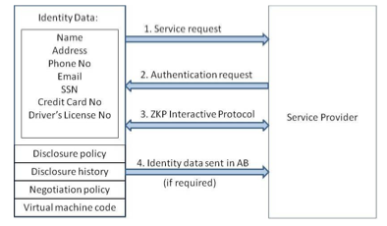
Minimize Loss of Control: IDM Usage Scenario (Approach – 1)

Slide 38
Minimize Loss of Control: IDM Approach - 2
Active Bundle scheme to protect PII from untrusted hosts
Predicates over encrypted data to authenticate without disclosing unencrypted identity data.
Multi-party computing to be independent of a trusted third party

Slide 39
Minimize Loss of Control: IDM Usage Scenario (Approach – 2)
Owner O encrypts Identity Data(PII) using algorithm Encrypt and O’s public key PK. Encrypt outputs CT—the encrypted PII.
SP transforms his request for PII to a predicate represented by function p.
SP sends shares of p to the n parties who hold the shares of MSK.
n parties execute together KeyGen using PK, MSK, and p, and return TKp to SP.
SP calls the algorithm Query that takes as input PK, CT, TKp and produces p(PII) which is the evaluation of the predicate.
The owner O is allowed to use the service only when the predicate evaluates to “true”.

Slide 40
Minimize Loss of Control: IDM Representation of identity information for negotiation
Token/Pseudonym
Identity Information in clear plain text
Active Bundle

Slide 41
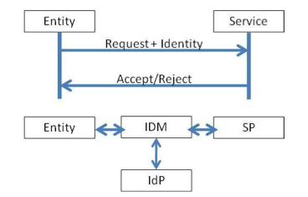
Minimize Loss of Control: IDM Motivation-Authentication Process using PII
Problem: Which information to disclose and how to disclose it.

Slide 42
Proposed IDM: Mechanisms
[16] Protection of Identity Information in Cloud Computing without Trusted Third Party - R. Ranchal, B. Bhargava, L.B. Othmane, L. Lilien, A. Kim, M. Kang, Third International Workshop on Dependable Network Computing and Mobile Systems (DNCMS) in conjunction with 29th IEEE Symposium on Reliable Distributed System (SRDS) 2010
[17] A User-Centric Approach for Privacy and Identity Management in Cloud Computing - P. Angin, B. Bhargava, R. Ranchal, N. Singh, L. Lilien, L.B. Othmane 29th IEEE Symposium on Reliable Distributed System (SRDS) 2010
Privacy in Cloud Computing Through Identity Management - B. Bhargava, N. Singh, A. Sinclair, International Conference on Advances in Computing and Communication ICACC-11, April, 2011, India.
Active Bundle
Anonymous Identification
Computing Predicates with encrypted data
Multi-Party Computing
Selective Disclosure

Slide 43
Proposed IDM: Active Bundle
Active bundle (AB)
An encapsulating mechanism protecting data carried within it
Includes data
Includes metadata used for managing confidentiality
Both privacy of data and privacy of the whole AB
Includes Virtual Machine (VM)
performing a set of operations
protecting its confidentiality

Slide 44
Proposed IDM: Active Bundle (Cont.)
Active Bundles—Operations
Self-Integrity check
E.g., Uses a hash function
Evaporation/ Filtering
Self-destroys (a part of) AB’s sensitive data when threatened with a disclosure
Apoptosis
Self-destructs AB’s completely

Slide 45
Proposed IDM: Active Bundle Scheme
Metadata:
Access control policies
Data integrity checks
Dissemination policies
Life duration
ID of a trust server
ID of a security server
App-dependent information
…
E(Name)
E(E-mail)
E(Password)
E(Shipping Address)
E(Billing Address)
E(Credit Card)
…
Sensitive Data:
Identity Information
...
Virtual Machine (algorithm):
Interprets metadata
Checks active bundle integrity
Enforces access and dissemination control policies
…
* E( ) - Encrypted Information

Slide 46
Proposed IDM: Anonymous Identification
Use of Zero-knowledge proofing for user authentication without disclosing its identifier.
User on Amazon Cloud
ZKP Interactive Protocol
User Request for service
Function f and number k
E-mail
Password
f_{k}(E-mail, Password) = R
E-mail
Password
Authenticated

Slide 47








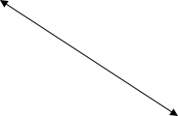





Proposed IDM: Interaction using Active Bundle
AB information disclosure
Active Bundle Destination
User Application
Active Bundle
Active Bundle Creator
Active
Bundle (AB)
Security Services
Agent (SSA)
Audit Services
Agent (ASA)
Directory
Facilitator
Trust Evaluation
Agent (TEA)
Active Bundle Coordinator
Active Bundle Services

Slide 48
Proposed IDM: Predicate over Encrypted Data
Verification without disclosing unencrypted identity data.
Predicate Request*
E-mail
Password
E(Name)
E(Shipping Address)
E(Billing Address)
E(Credit Card)
E(Name)
E(Billing Address)
E(Credit Card)
*Age Verification Request
*Credit Card Verification Request

Slide 49
Proposed IDM: Multi-Party Computing
To become independent of a trusted third party
Multiple Services hold shares of the secret key
Minimize the risk
Predicate Request
E(Name)
E(Billing Address)
E(Credit Card)
K’₁
K’₂
K’₃
K’_{n}
Key Management Services
* Decryption of information is handled by the Key Management services

Slide 50
Proposed IDM: Multi-Party Computing
To become independent of a trusted third party
Multiple Services hold shares of the secret key
Minimize the risk
Predicate Reply*
Name
Billing Address
Credit Card
K’₁
K’₂
K’₃
K’_{n}
Key Management Services
*Age Verified
*Credit Card Verified

Slide 51
Proposed IDM: Selective Disclosure
User Policies in the Active Bundle dictate dissemination
Selective disclosure*
E-mail
Password
E(Name)
E(Shipping Address)
E(Billing Address)
E(Credit Card)
E(E-mail)
E(Name)
E(Shipping Address)
*e-bay shares the encrypted information based on the user policy

Slide 52
Proposed IDM: Selective Disclosure
User Policies in the Active Bundle dictate dissemination
Selective disclosure*
E-mail
Password
E(Name)
E(Shipping Address)
E(Billing Address)
E(Credit Card)
E-mail
E(Name)
E(Shipping Address)
Decryption handled by Multi-Party Computing as in the previous slides

Slide 53
Proposed IDM: Selective Disclosure
Selective disclosure*
E-mail
E(Name)
E(Shipping Address)
E(Name)
E(Shipping Address)
*e-bay seller shares the encrypted information based on the user policy

Slide 54
Proposed IDM: Selective Disclosure
Selective disclosure
E-mail
E(Name)
E(Shipping Address)
Name
Shipping Address
Decryption handled by Multi-Party Computing as in the previous slides

Slide 55


Proposed IDM: Selective Disclosure
Selective disclosure
E-mail
E(Name)
E(Shipping Address)
Name
Shipping Address
Fed-Ex can now send the package to the user

Slide 56
Proposed IDM: Identity in the Cloud
User on Amazon Cloud
E-mail
Password
Name
Billing Address
Credit Card
Name
E-mail
Password
Billing Address
Shipping Address
Credit Card
E-mail
Name
Shipping Address

Slide 57
Proposed IDM: Characteristics and Advantages
Ability to use Identity data on untrusted hosts
Self Integrity Check
Integrity compromised- apoptosis or evaporation
Data should not be on this host
Independent of Third Party
Prevents correlation attacks
Establishes the trust of users in IDM
Through putting the user in control of who has his data
Identity is being used in the process of authentication, negotiation, and data exchange.
Minimal disclosure to the SP
SP receives only necessary information.

Slide 58
Proposed IDM: Conclusion & Future Work
Problems with IDM in Cloud Computing
Collusion of Identity Information
Prohibited Untrusted Hosts
Usage of Trusted Third Party
Proposed Approaches
IDM based on Anonymous Identification
IDM based on Predicate over Encrypted data
Future work
Develop the prototype, conduct experiments and evaluate the approach

Slide 59
Minimize Multi-tenancy

Slide 60
Minimize Multi-tenancy
Can’t really force the provider to accept less tenants
Can try to increase isolation between tenants
Strong isolation techniques (VPC to some degree)
C.f. VM Side channel attacks (T. Ristenpart et al.)
QoS requirements need to be met
Policy specification
Can try to increase trust in the tenants
Who’s the insider, where’s the security boundary? Who can I trust?
Use SLAs to enforce trusted behavior

Slide 61
Conclusion
Cloud computing is sometimes viewed as a reincarnation of the classic mainframe client-server model
However, resources are ubiquitous, scalable, highly virtualized
Contains all the traditional threats, as well as new ones
In developing solutions to cloud computing security issues it may be helpful to identify the problems and approaches in terms of
Loss of control
Lack of trust
Multi-tenancy problems

Slide 62
CLOUD COMPUTING FOR MOBILE USERS: CAN OFFLOADING COMPUTATION SAVE ENERGY?

Slide 63
What cloud gives us, generally
Take Amazon cloud for example.
store personal data
(Simple Storage Service (S3) )
perform computations on stored data
(Elastic Compute Cloud (EC2). )
Notes:
你好

Slide 64
What cloud gives us, generally
If you want to set up a business.
low initial capital investment
shorter start-up time for new services
lower maintenance and operation costs
higher utilization through virtualization
easier disaster recovery

Slide 65
What about cloud computing for mobile users? Specifically
Two main concerns:
mobile computing are limited energy
wireless bandwidth

Slide 66
The importance of battery lifetime of mobile phones
Various studies have identified longer battery
lifetime as the most desired feature of such
systems.
longer battery life to be more important than all other features, including cameras or storage.
short battery life to be the most disliked characteristic of Apple’s iPhone 3GS
battery life was the top concern of music phone users.

Slide 67
Four basic approaches to saving energy and extending battery lifetime in mobile devices:
Adopt a new generation of semiconductor technology.
Avoid wasting energy. (when it is idle, sleep mode)
Execute programs slowly. (When a processor’s clock speed doubles, the power consumption nearly octuples).
Eliminate computation all together. (offloading these applications to the cloud).

Slide 68

Can offloading these applications to the cloud save energy and extend battery lifetimes for mobile users?
How to implement a quantitative study. The amount of energy saved is
S : the speed of cloud to compute C instructions
M : the speed of mobile to compute C instructions
D : the data need to transmit
B : the bandwidth of the wireless Internet

Slide 69
Can offloading these applications to the cloud save energy and extend battery lifetimes for mobile users?
the energy cost per second when the mobile phone is doing computing
the energy cost per second when the mobile phone is idle.
the energy cost per second when the mobile is transmission the data.

Slide 70

Can offloading these applications to the cloud save energy and extend battery lifetimes for mobile users?
Suppose the server is F times faster—that is, S
= F × M. We can rewrite the formula as
Energy is saved when this formula produces a
positive number. The formula is positive if D/B
is sufficiently small compared with C/M and F
is sufficiently large.

Slide 71
sample applications benefiting from offloading
chess game.
A chessboard has 8 × 8 = 64 positions. Each
player controls 16 pieces at the beginning of
the game. Each piece may be in one of the 64
possible locations and needs 6 bits to
represent the location. To represent a chess
game’s current state, it is sufficient to state
that 6 bits × 32 pieces = 192 bits = 24 bytes;
this is smaller than the size of a typical
wireless packet.

Slide 72
sample applications benefiting from offloading
The amount of computation for chess is very
large; Claude Shannon and Victor Allis
estimated the complexity of chess to exceed
the number of atoms in the universe. Since the
amount of computation C is extremely large,
and D is very small, chess provides an example
where offloading is beneficial for most wireless
networks.

Slide 73
sample applications not benefiting from offloading
regions like national parks
the basement of a building
interior of a tunnel,
subway.
In these cases,
where the value of B in Equation can become
very small or even zero, cloud computing does
not save energy.

Slide 74
Making computation offloading more attractive
There is a fundamental assumption
under-lying this analysis with the client-server
model: Because the server does not already
contain the data, all the data must be sent to
the service provider.
However, cloud computing changes that
assumption: The cloud stores data and performs
computation on it. For example, services like
Amazon S3 can store data, and Amazon EC2 can
be used to perform computation on the data
stored using S3.

Slide 75
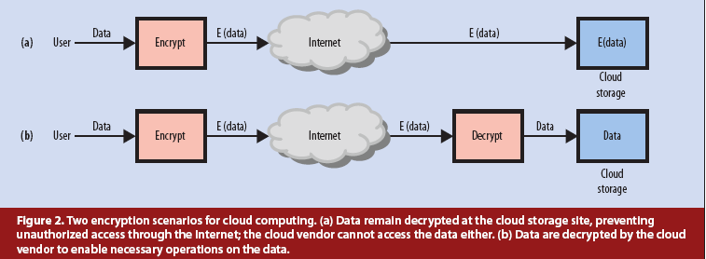
When considering Privacy and security

Slide 76
When considering Privacy and security
Another possible privacy and security solution
is to use a technique called steganography :
Multimedia content like images and videos
have significant redundancy. This makes it
possible to hide data in multimedia using
steganography.
Steganographic techniques can be used to
transform the data before storage so that
operations can still be performed on the data.

Slide 77
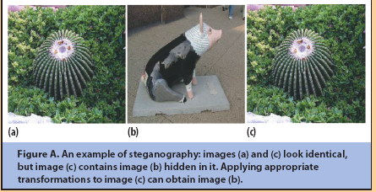
When considering Privacy and security

Slide 78

When considering Privacy and security
Performing encryption or steganographic
techniques before sending data to the cloud
requires some additional processing on the
mobile system. So the formula become:

Slide 79
Conclusion
cloud computing can potentially save energy
for mobile users.
not all applications are energy
efficient when migrated to the cloud.
cloud computing services would be
significantly different from cloud services for
desktops because they must offer energy
savings.
The services should consider the energy
overhead for privacy, security, reliability,
and data communication before offloading.

Slide 80
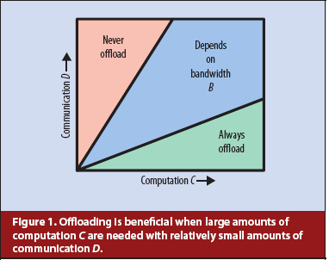
Conclusion

Slide 81
Bandwidth Measurements for VMs in Cloud

Slide 82
MOTIVATION
Many applications are being deployed in cloud to leverage the scalability provided by the cloud providers.
Tools provided by the cloud providers do not give performance metrics from the network perspective.
Network topology is not exposed to the cloud users and the applications consider all network links to be homogeneous.
Metrics such as available bandwidth, latency etc. will be more useful to the cloud users.

Slide 83
Experimental Evaluation
Set up
19 EC2 small instances (US East)
342 links between VMs
Ubuntu 10.04 server version
Centralized Scheduler for starting Iperf clients
Predefined serialized schedule file at each VM instance.
Schedule file contains a time stamp along with the nodes that should communicate for a single reading.
* Iperf - Network testing tool to measure the network
throughput between end hosts.

Slide 84
Experimental Evaluation
Iperf takes 6 seconds to get a reading for a single link.
Each round of measurement takes around 30 minutes for finding available bandwidth for all 342 links.
Total 5 rounds in total
Throughput matrix: Matrix containing estimated values for available bandwidth

Slide 85
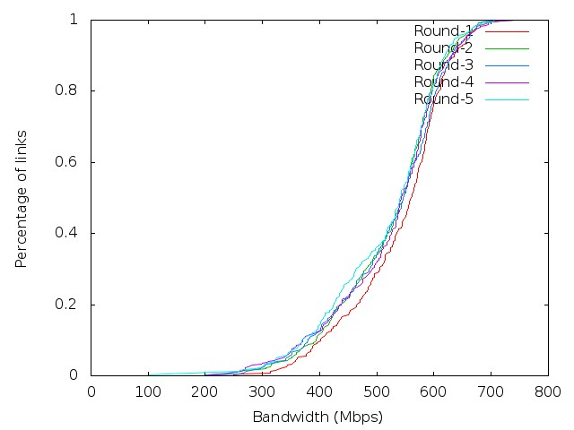
Bandwidth Estimation
Shows the CDF of link bandwidth estimation for all the rounds.
Used throughput matrix having estimated 342 values.
All links in clouds are not homogeneous.
Only 10% of the links have available bandwidth less than 400Mbps.

Slide 86
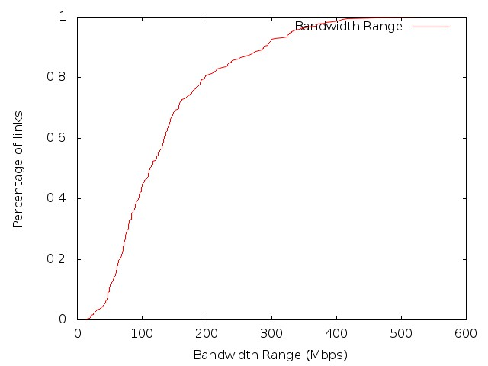
Bandwidth Variation Estimation
Shows the CDF of link bandwidth variation across all the rounds.
Bandwidth range of a link defined as the difference between the max and min value across all rounds.
For most of the links, bandwidth is consistent across time. Only 20% links have variation of more than 200 Mbps.

Slide 87
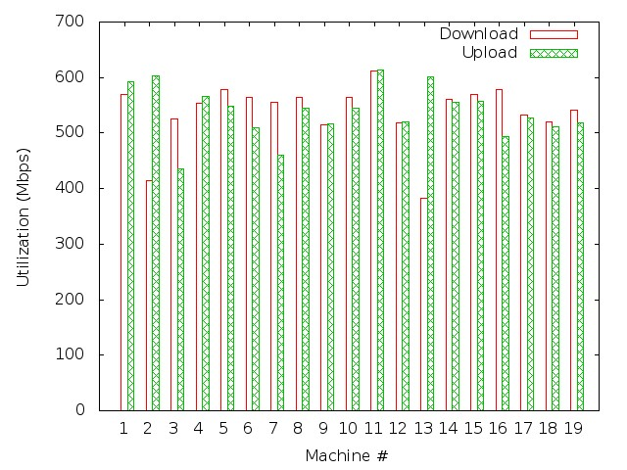
Virtual Machine Performance
Shows the available download/upload bandwidth of all machines for a single round
Almost all the machines have average available bandwidth more than 400 Mbps.

Slide 88
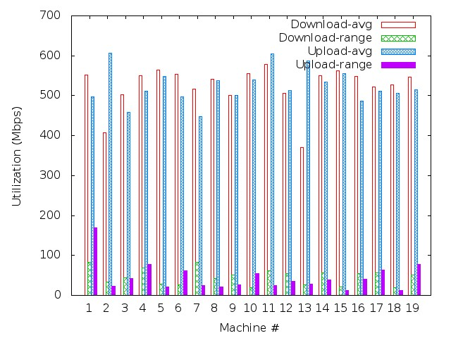
Virtual Machine Performance
Shows the average available download/ upload bandwidth and its range for each machine across all rounds.
Almost all the machines have average download/ upload bandwidth more than 400 Mbps.
Some VMs (1, 4, 7) have large available bandwidth variation.

Slide 89
CONCLUSIONS
Focussed on available bandwidth metric between each pair of VM instances.
Amazon EC2 data center is optimally utilized with ample available bandwidth for almost all VMs.
Some badly performing VMs can be pointed out based on the large variation in the available upload/download bandwidth and can be replaced with new VMs.

Slide 90
Future Work
More performance metric such as latency etc. can be considered.
These performance metrics can be used to improve the performance of applications running in the cloud.
These performance metric tests can be run on large EC2 instances.

Slide 91
A Mobile-Cloud Collaborative Approach for Context-Aware Blind Navigation

Slide 92
Outline
Problem Statement
Goals
Challenges
Context-aware Navigation Components
Existing Blind Navigation Aids
Proposed System Architecture
Advantages of Mobile-Cloud Approach
Traffic Lights Detection
Related Work
System Developed
Experiments
Work In Progress

Slide 93
Problem Statement
Indoor and outdoor navigation is becoming a harder task for blind and visually impaired people in the increasingly complex urban world
Advances in technology are causing the blind to fall behind, sometimes even putting their lives at risk
Technology available for context-aware navigation of the blind is not sufficiently accessible; some devices rely heavily on infrastructural requirements

Slide 94
Demographics
314 million visually impaired people in the world today
45 million blind
More than 82% of the visually impaired population is age 50 or older
The old population forms a group with diverse range of abilities
The disabled are seldom seen using the street alone or public transportation

Slide 95
Goals
***Make a difference***
Bring mobile technology in the daily lives of blind and visually impaired people to help achieve a higher standard of life
Take a major step in context-aware navigation of the blind and visually impaired
Bridge the gap between the needs and available technology
Guide users in a non-overwhelming way
Protect user privacy

Slide 96
Challenges
Real-time guidance
Portability
Power limitations
Appropriate interface
Privacy preservation
Continuous availability
No dependence on infrastructure
Low-cost solution
Minimal training

Slide 97
Discussions
Cary Supalo: Founder of Independence Science LLC (http://www.independencescience.com/)
T.V. Raman: Researcher at Google, leader of Eyes-Free project (speech enabled Android applications)
American Council of the Blind of Indiana State Convention, 31 October 2009
Miami Lighthouse Organization

Slide 98
Mobility Requirements
Being able to avoid obstacles
Walking in the right direction
Safely crossing the road
Knowing when you have reached a destination
Knowing which is the right bus/train
Knowing when to get off the bus/train
All require SIGHT as primary sense

Slide 99
Context-Aware Navigation Components
Outdoor Navigation (finding curbs -including in snow, using public transportation, interpreting traffic patterns/signal lights…)
Indoor Navigation (finding stairs/elevator, specific offices, restrooms in unfamiliar buildings, finding the cheapest TV at a store…)
Obstacle Avoidance (both overhanging and low obstacles…)
Object Recognition (being able to reach objects needed, recognizing people who are in the immediate neighborhood…)

Slide 100
Existing Blind Navigation Aids – Outdoor Navigation
Loadstone GPS (http://www.loadstone-gps.com/)
Wayfinder Access (http://www.wayfinderaccess.com/)
BrailleNote GPS (www.humanware.com)
Trekker (www.humanware.com)
StreetTalk (www.freedomscientific.com)
DRISHTI [1]
…

Slide 101
Existing Blind Navigation Aids – Indoor Navigation
InfoGrid (based on RFID) [2]
Jerusalem College of Technology system (based on local infrared beams) [3]
Talking Signs (www.talkingsigns.com) (audio signals sent by invisible infrared light beams)
SWAN (audio interface guiding user along path, announcing important features) [4]
ShopTalk (for grocery shopping) [5]

Slide 102
Existing Blind Navigation Aids – Obstacle Avoidance
RADAR/LIDAR
Kay’s Sonic glasses (audio for 3D representation of environment) (www.batforblind.co.nz)
Sonic Pathfinder (www.sonicpathfinder.org) (notes of musical scale to warn of obstacles)
MiniGuide (www.gdp-research.com.au/) (vibration to indicate object distance)
VOICE (www.seeingwithsound.com) (images into sounds heard from 3D auditory display)
Tactile tongue display [6]
…

Slide 103
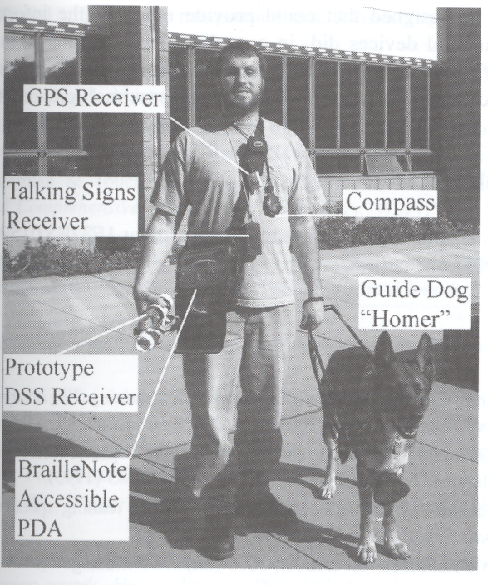
Putting all together…
Gill, J. Assistive Devices for People with Visual Impairments.
In A. Helal, M. Mokhtari and B. Abdulrazak, ed., The Engineering Handbook of Smart Technology for Aging, Disability and Independence.
John Wiley & Sons, Hoboken, New Jersey, 2008.

Slide 104
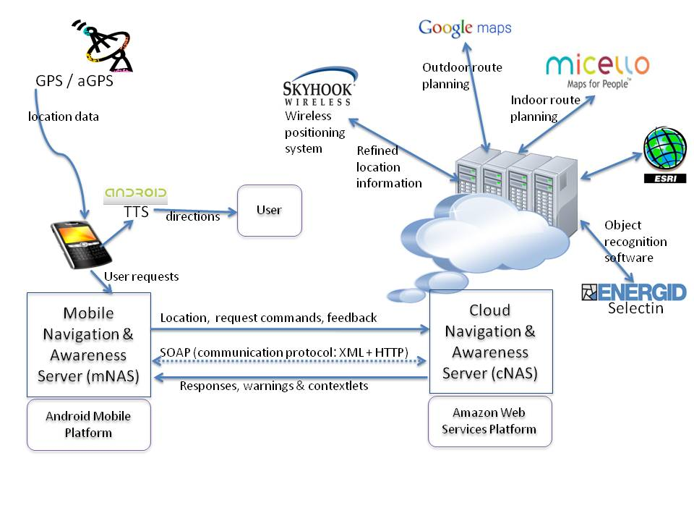
Proposed System Architecture

Slide 105
Proposed System Architecture
Services:
Google Maps (outdoor navigation, pedestrian mode)
Micello (indoor location-based service for mobile devices)
Object recognition (Selectin software etc)
Traffic assistance
Obstacle avoidance (Time-of-flight camera technology)
Speech interface (Android text-to-speech + speech recognition servers)
Remote vision
Obstacle minimized route planning

Slide 106
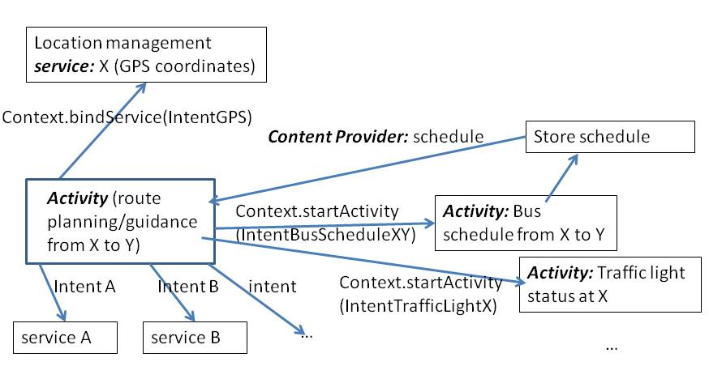
Use of the Android Platform

Slide 107
Advantages of a Mobile-Cloud Collaborative Approach
Open architecture
Extensibility
Computational power
Battery life
Light weight
Wealth of context-relevant information resources
Interface options
Minimal reliance on infrastructural requirements

Slide 108
Traffic Lights Status Detection Problem
Ability to detect status of traffic lights accurately is an important aspect of safe navigation
Color blind
Autonomous ground vehicles
Careless drivers
Inherent difficulty: Fast image processing required for locating and detecting the lights status → demanding in terms of computational resources
Mobile devices with limited resources fall short alone

Slide 109
Attempts to Solve the Traffic Lights Detection Problem
Kim et al: Digital camera + portable PC analyzing video frames captured by the camera [7]
Charette et al: 2.9 GHz desktop computer to process video frames in real time[8]
Ess et al: Detect generic moving objects with 400 ms video processing time on dual core 2.66 GHz computer[9]
Sacrifice portability for real-time, accurate detection

Slide 110
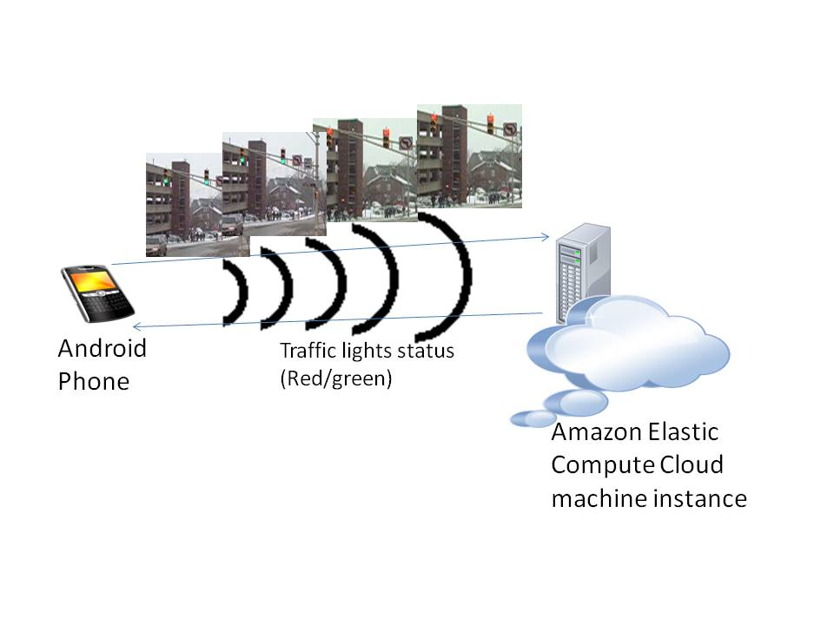
Mobile-Cloud Collaborative Traffic Lights Detector

Slide 111
Adaboost Object Detector
Adaboost: Adaptive Machine Learning algorithm used commonly in real-time object recognition
Based on rounds of calls to weak classifiers to focus more on incorrectly classified samples at each stage
Traffic lights detector: trained on 219 images of traffic lights (Google Images)
OpenCV library implementation

Slide 112
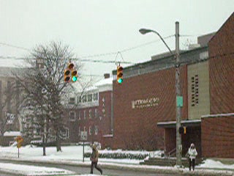
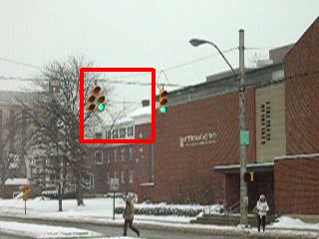
Experiments: Detector Output

Slide 113
Experiments: Response time

Slide 114
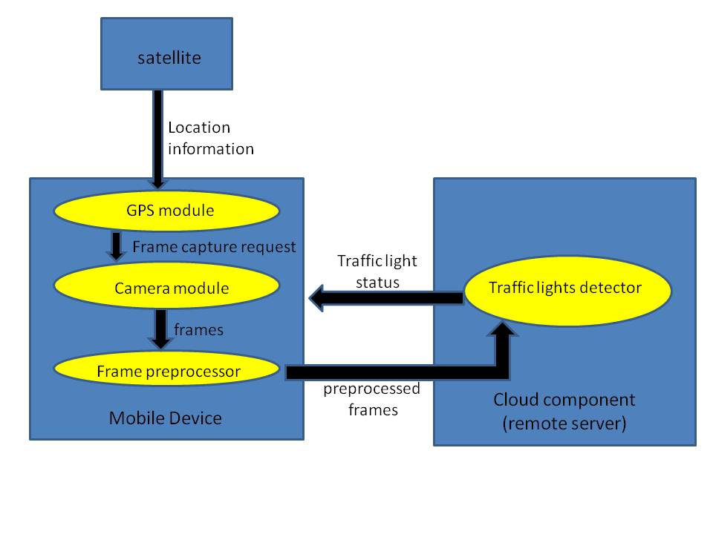
Enhanced Detection Schema

Slide 115
Work In Progress
Develop fully context-aware navigation system with speech/tactile interface
Develop robust object/obstacle recognition algorithms
Investigate mobile-cloud privacy and security issues (minimal data disclosure principle) [10]
Investigate options for mounting of the camera

Slide 116
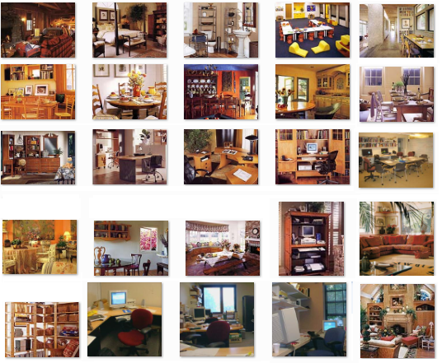
Collective Object Classification in Complex Scenes
LabelMe Dataset (http://labelme.csail.mit.edu)

Slide 117
Relational Learning with Multiple Boosted Detectors for Object Categorization
Modeling relational dependencies between different object categories
Multiple detectors running in parallel
Class label fixing based on confidence
More accurate classification than AdaBoost alone
Higher recall than classic collective classification
Minimal decrease in recall for different classes of objects

Slide 118
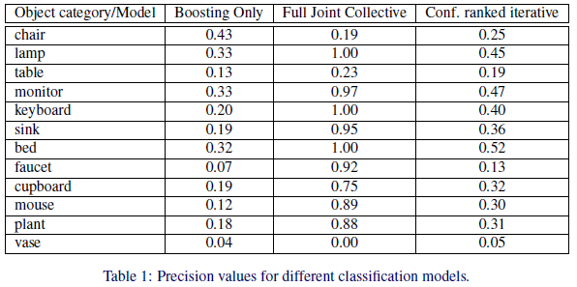
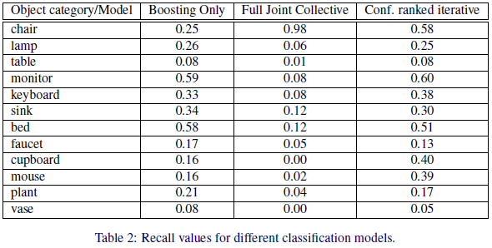
Object Classification Experiments

Slide 119
Identity-Based Authentication for Cloud Computing
Hongwei Li, Yuanshun Dai, Ling Tian, and Haomiao Yang
CloudCom ‘09

Slide 120
What did they do?
Proposed identity-based authentication for cloud computing, based on the identity-based hierarchical model for cloud computing (IBHMCC) and corresponding encryption and signature schemes
Being certificate-free, the authentication protocol aligned well with demands of cloud computing

Slide 121
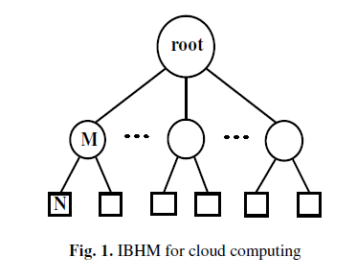
Identity-Based Hierarchical Model for Cloud Computing (IBHMCC)
Define the identity of node is the DN string from the root node to the current node itself.
The identity of entity N is
ID_N = DN_0 || DN_M || DN_N

Slide 122
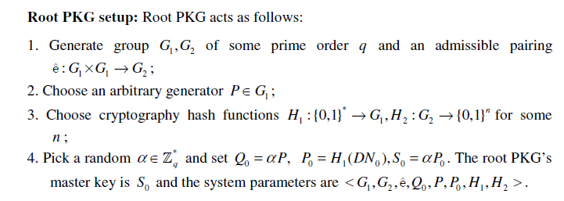
Deployment of IBHMCC
Root PKG setup and Low-level setup

Slide 123
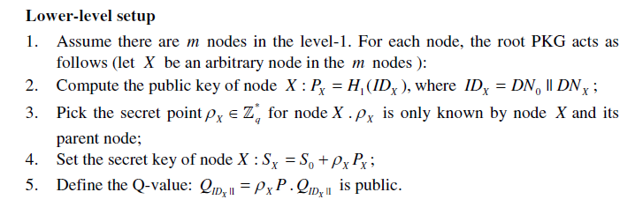
Deployment of IBHMCC (cont.)
After that, all nodes in the level-1 get and securely keep their secret keys and the secret points.
The public key and the Q-value are publicized.
Then, Each node in the level-1 similarly repeats the above steps (2-5).

Slide 124
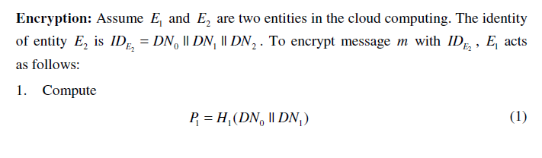
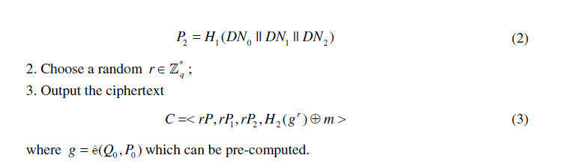
Identity-Based Encryption

Slide 125
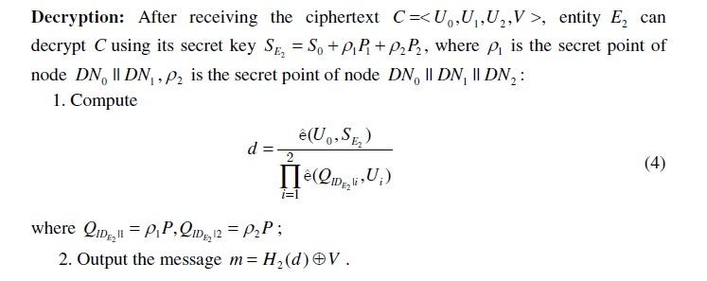
Identity-Based Encryption (cont.)

Slide 126
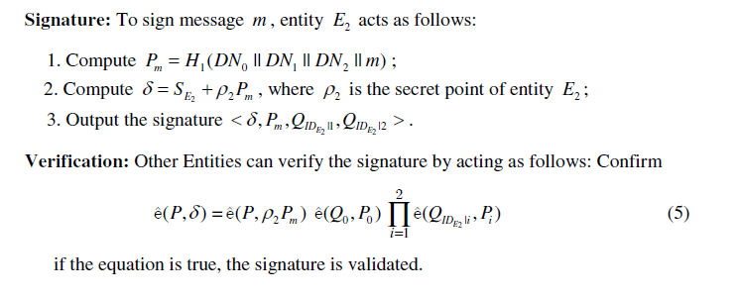
Identity-Based Signature

Slide 127
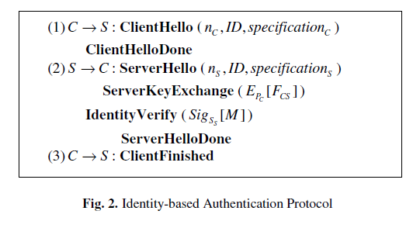
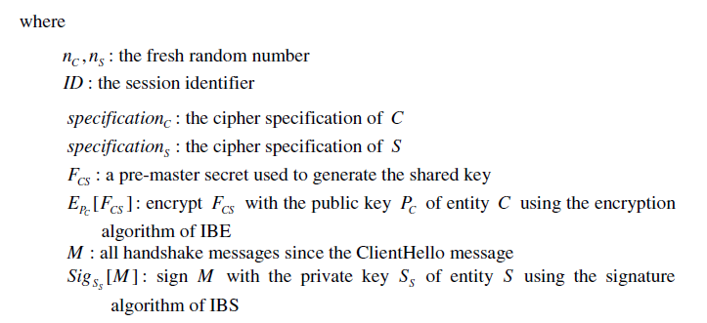
Identity-Based Authentication for Cloud Computing
Extends from TLS to handle the IBE and IBS schemes

Slide 128
A Simple Technique for Securing Data at Rest Stored in a Computing Cloud
Jeff Sedayao, Steven Su, Xiaohao Ma, Minghao Jiang, and Kai Miao
CloudCom ’09

Slide 129
What did they do?
Simple technique implemented with Open Source software solves the confidentiality of data stored on Cloud Computing Infrastructure by using public key encryption to render stored data at rest unreadable by unauthorized personnel, including system administrators of the cloud computing service on which the data is stored
Validated their approach on a network measurement system implemented on PlanetLab
Used it on a service where confidentiality is critical – a scanning application that validates external firewall implementations

Slide 130
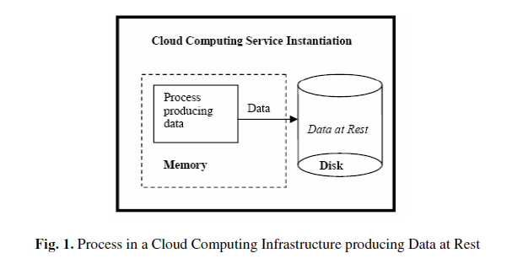
Problem Scope
Goal is to ensure the confidentiality of data at rest
“Data at rest” means that the data that is stored in a readable form on a Cloud Computing service, whether in a storage product like S3 or in a virtual machine instance as in EC2

Slide 131
Problem Scope (cont.)
To protect data at rest, they want to prevent other users in the cloud infrastructure who might have access to the same storage from reading the data our process has stored
They also want to prevent system administrators who run the cloud computing service from reading the data.
They assume that it is unlikely for an adversary to snoop on the contents of memory.
If the adversary had that capability, it is unlikely that we could trust the confidentiality of any of the data that we generated there.

Slide 132
Problem Scope (cont.)
While the administrative staff of the cloud computing service could theoretically monitor the data moving in memory before it is stored in disk, we believe that administrative and legal controls should prevent this from happening.
They also do not guard against the modification of the data at rest, although we are likely to be able to detect this.

Slide 133
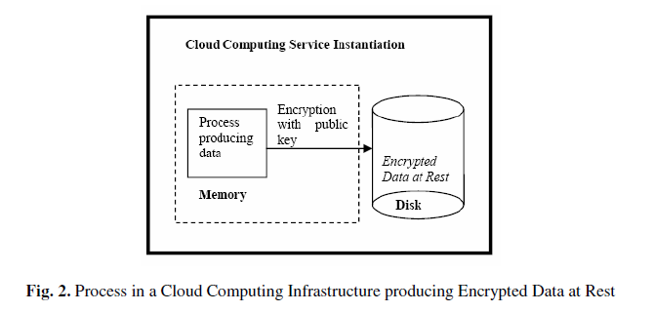
Solution Design

Slide 134
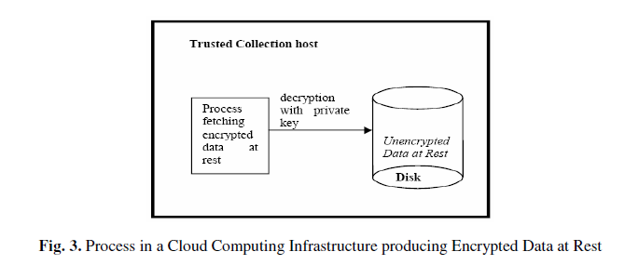
Solution Design (cont.)
On a trusted host, collect the encrypted data, as shown in Figure 3, and decrypt it with the collection agent’s private key which stays on that host. Note that in this case, we are in exclusive control of the private key, which the cloud service provider has no view or control over.
They will discuss this feature of our solution later.

Slide 135
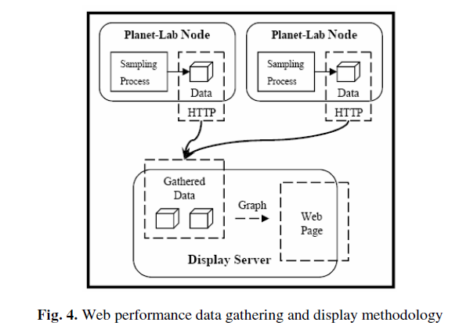
Implementation Experiences

Slide 136
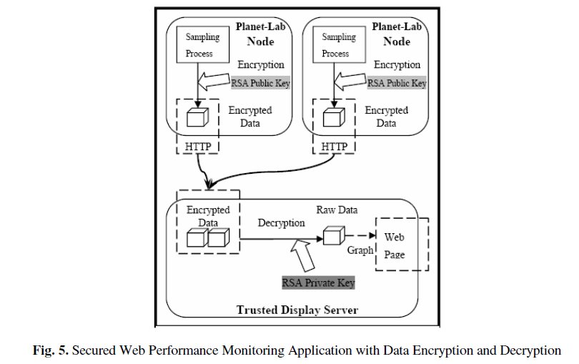
Implementation Experiences (cont.)

Slide 137
Privacy in a Semantic Cloud: What’s Trust Got to Do with It?
Åsmund Ahlmann Nyre and Martin Gilje Jaatun
CloudCom’09

Slide 138
What did they do?
A brief survey on recent work on privacy and trust for the semantic web, and sketch a middleware solution for privacy protection that leverages probabilistic methods for automated trust and privacy management for the semantic web

Slide 139
Trust Management
Definition of trust
The willingness of a party to be vulnerable to the actions of another party based on the expectation that the other will perform a particular action important to the trustor, irrespective of the ability to monitor and control that other party.

Slide 140
Trust Management (cont.)
Trust Models
Mayer, R., Davis, J., Schoorman, F.: An integrative model of organizational trust. Academy of Management Review
The main factors of trustworthiness were identified as ability, benevolence and integrity.
On the trustor’s part, disposition to trust and perceived risk were identified as the most influential factors with regards to trust.
Furthermore, the outcome of a trust relation (experience) is assumed to influence one or more of the trustworthiness factors and hence the trustworthiness of the trustee.

Slide 141
Trust Management (cont.)
Trust Models
The complexity of several proposed models does not necessarily give better trust assessments
Conrad, M., French, T., Huang, W., Maple, C.: A lightweight model of trust propagation in a multi-client network environment: to what extent does experience matter?
Proposed a lightweight model for trust propagation. The parameters self confidence, experience, hearsay and prejudice are used to model and assess trust. This computational model also allows agents to compute a trust value to automatically perform trust decisions.

Slide 142
Trust Management (cont.)
Trust Models
Gil, Y., Artz, D.: Towards content trust of web resources
The idea is to arrive at content trust, where the information itself is used for trust calculation.
This allows for a whole new range of parameters (such as bias, criticality, appearance, etc.) to be used when assessing trust in resources.
The problem of such parameters is that they require user input, which conflicts with the assumption of agents conducting the assessment autonomously.

Slide 143
Trust Management (cont.)
Trust Propagation
Golbeck, J., Hendler, J.: Accuracy of metrics for inferring trust and reputation in semantic web-based social networks
Inferring trust and reputation in social networks when entities are not connected directly by a trust relationship.
Done by computing the weighted distance from the source to the sink.
Any distrusted entity is not included in the computation since the trust assessments done by such entities are worthless.

Slide 144
Trust Management (cont.)
Trust Propagation
Guha, R., Kumar, R., Raghavan, P., Tomkins, A.: Propagation of trust and distrust
Introduce the notion of distrust to address the problem of expressing explicit distrust as a contrast to the absence of trust.
Absence of trust may come from lack of information to conduct a proper trust assessment, while distrust expresses that a proper assessment have been conducted and that the entity should not be trusted.
Furthermore, they argue that distrust could also be propagated and proposes several propagation models in addition to trust transitivity, including co-citation, which is extensively used for web searches.

Slide 145
Trust Management (cont.)
Trust Propagation
Huang, J., Fox, M.S.: An ontology of trust: formal semantics and transitivity
claim that not all kinds of trust can be assumed to be transitive.
They note that trust based on performance, i.e. an entity performing as expected repeatedly, is not necessarily transitive, while trust based on a belief that the entity will perform as expected often is.

Slide 146
Probabilistic Privacy Policy Enforcement
A probabilistic approach to policy enforcement, where users are given a probability that their requirements will be respected and polices enforced.
Thus when interacting with websites who are known to be less trustworthy, policy adherence is given by a probability metric that the website will actually enforce its own policies.
This enforcement model does not include a privacy or trust model
i.e. it is only occupied with how to handle uncertainty in enforcement and provide a tool for interacting with non-conforming entities while minimising the risks involved.

Slide 147
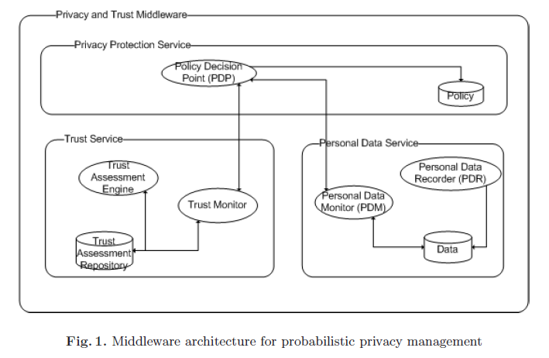
Probabilistic Privacy Policy Enforcement (cont.)

Slide 148
Probabilistic Privacy Policy Enforcement (cont.)
Personal Data Recorder (PDR)
Protecting users from this kind of aggregation requires complete control of what information has been distributed and to whom.
Records what data is transmitted to which receivers.
Example: Consider the situation where a user wanting to stay unidentified has provided his postal code and anonymous e-mail address to a website. Later he also provides age and given name (not the full name) and the anonymous e-mail address. Now, the website is able to combine the data (postal code, age and given name) to identify the anonymous user
The second interaction with the website should have been blocked, since it enables the website to reveal the user’s identity. The PDR allows the user to view himself through the eyes of the receiving party, and thereby perform aggregation to see whether too much information is provided.

Slide 149
Probabilistic Privacy Policy Enforcement (cont.)
Personal Data Monitor (PDM)
Computing and assessing policies and behaviour, and to update the personal data recorder with inferred knowledge.
Determine the likelihood that the personal information distributed to the receiver will also reach other.
Example: sending an e-mail with a business proposition to a specific employee of a company, it is likely that other employees in that company also will receive the e-mail (e.g. his superior).
PDM is responsible for inferring other recipients and to include such information in the Personal Information Base.
Hence, any interaction later on should consider this information when assessing the kind of information to reveal.

Slide 150
Probabilistic Privacy Policy Enforcement (cont.)
Trust Assessment Engine (TAE)
Calculating trust values of different entities in order to determine their trustworthiness.
The TAE is focused solely on assessing communicating parties and does not take into account risk willingness, vulnerability and criticality.

Slide 151
Probabilistic Privacy Policy Enforcement (cont.)
Trust Monitor (TM)
Detecting events that might affect the perceived trustworthiness and the willingness to take risks.
Calculating and deciding on what is an acceptable trust level, given the circumstances.
Any computed trust value and feedback received from cooperating entities is stored in the trust assessment repository

Slide 152
Probabilistic Privacy Policy Enforcement (cont.)
Policy Decision Point (PDP)
The final decision on whether to engage in information exchange and if so; under what conditions.
Collects the views of both the TM and the PDM and compares their calculations to the policies and requirements found in the policy repository.
The decision is reported back to the TM and PDM to allow recalculation in case the decision alters the calculated trust values or distribution of personal information

Slide 153
Towards an Approach of Semantic Access Control for Cloud Computing
Luokai Hu, Shi Ying, Xiangyang Jia, and Kai Zhao
CloudCom’09

Slide 154
What did they do?
Analysis existing access control methods and present a new Semantic Access Control Policy Language (SACPL) for describing Access Control Policies (ACPs) in cloud computing environment.
Access Control Oriented Ontology System (ACOOS) is designed as the semantic basis of SACPL.
Ontology-based SACPL language can effectively solve the interoperability issue of distributed ACPs.

Slide 155
Access Control Oriented Ontology System (ACOOS)
Provide the common understandable semantic basis for access control in cloud computing environments.
Divided into four parts, Subject Ontology, Object Ontology, Action Ontology and Attribute Ontology
Web Ontology Language (OWL) is selected as the modeling language of ACOOS.
Ontology is helpful to construct authorization policy within the scope of whole cloud computing environment based on policy definition elements with determined semantics.
Notes:
All authorization entities (subject, object or action) and their attributes should be understood as the unambiguous meaning in the cloud computing environment.
The action should be determined in according with the policy to ensure that policy administrator of cloud computing environment can define the ACPs an entities which can be understood by other administrators in different applications.

Slide 156
Access Control Oriented Ontology System (ACOOS)
Subject Ontology
Subject is the entity that has a number of action permissions over object.
e.g., a user, a user group, an organization, a role, a process, a service
Attribute of a subject is described by the data property
The role in subject ontology represents the capability of a subject to implement a task.
Access permission of resources can be encapsulated in the role.
If a subject is assigned to a role, it can access the resources indirectly.

Slide 157
Access Control Oriented Ontology System (ACOOS)
Object Ontology
Object is the entity as receptor of action and is need for protection.
e.g., data, documents, services and other resources.
Attribute of an object is described by the data property and object property of OWL with hasObjectDataAttribute and hasObjectAttribute respectively.
Object group can also be used to define the rule to organize objects.
Each object group in fact establishes a new object concept, all object individuals of the object concept have object attribute values of the object group.

Slide 158
Access Control Oriented Ontology System (ACOOS)
Action Ontology
With the cloud computing technology, usually a large number of subjects and objects but only a relatively small number of actions could be found
e.g., such as reading, writing and execution
Action also has properties, known as the ActionAttribute, which describes various information of action for authorization and management.
Action group can be defined with helpful for the definition of rules.
The definition of action group, nearly the same with the object group, will not repeat it again.

Slide 159
Access Control Oriented Ontology System (ACOOS)
Attribute Ontology
Attribute types are defined in the attribute ontology, can be used to define the attribute of almost all entities, including the subject, object and action.
The attribute value of entities is often needed to determine whether meet the Permit conditions or Deny ones.

Slide 160
Semantic Access Control Policy Language (SACPL)
Policy markup language, such as XACML, supports description and management of distributed policies.
The ACP of an object (resource) may be completed by a number of departments even organizations, such as information systems department, human resources and financial department.
The same ACP may be applied to the internal network protection, e-mail system, remote access systems, or a cloud computing platform.
As a result, in cloud computing environment, the issue of interoperability among policies is more important than ever before.

Slide 161
References
NIST (Authors: P. Mell and T. Grance), "The NIST Definition of Cloud Computing (ver. 15)," National Institute of Standards and Technology, Information Technology Laboratory (October 7 2009).
J. McDermott, (2009) "Security Requirements for Virtualization in Cloud Computing," presented at the ACSAC Cloud Security Workshop, Honolulu, Hawaii, USA, 2009.
J. Camp. (2001), “Trust and Risk in Internet Commerce,” MIT Press
T. Ristenpart et al. (2009) “Hey You Get Off My Cloud,” Proceedings of the 16th ACM conference on Computer and communications security, Chicago, Illinois, USA
Security and Privacy in Cloud Computing, Dept. of CS at Johns Hopkins University. www.cs.jhu.edu/~ragib/sp10/cs412
Cloud Security and Privacy: An Enterprise Perspective on Risks and Compliance by Tim Mather and Subra Kumaraswamy
Afraid of outside cloud attacks? You're missing the real threat. http://www.infoworld.com/d/cloud-computing/afraid-outside-cloud-attacks-youre-missing-real-threat-894
Amazon downplays report highlighting vulnerabilities in its cloud service. http://www.computerworld.com/s/article/9140074/Amazon_downplays_report_highlighting_vulnerabilities_in_its_cloud_service
Targeted Attacks Possible in the Cloud, Researchers Warn. http://www.cio.com/article/506136/Targeted_Attacks_Possible_in_the_Cloud_Researchers_Warn
Vulnerability Seen in Amazon's Cloud-Computing by David Talbot. http://www.cs.sunysb.edu/~sion/research/sion2009mitTR.pdf
Cloud Computing Security Considerations by Roger Halbheer and Doug Cavit. January 2010. http://blogs.technet.com/b/rhalbheer/archive/2010/01/30/cloud-security-paper-looking-for-feedback.aspx
Security in Cloud Computing Overview.http://www.halbheer.info/security/2010/01/30/cloud-security-paper-looking-for-feedback
Hey, You, Get Off of My Cloud: Exploring Information Leakage in Third-Party Compute Clouds by T. Ristenpart, E. Tromer, H. Shacham and Stefan Savage. CCS’09
Cloud Computing Security. http://www.exforsys.com/tutorials/cloud-computing/cloud-computing-security.html
Update From Amazon Regarding Friday’s S3 Downtime by Allen Stern. Feb. 16, 2008. http://www.centernetworks.com/amazon-s3-downtime-update
R. Ranchal, B. Bhargava, L.B. Othmane, L. Lilien, A. Kim, M. Kang, “Protection of Identity Information in Cloud Computing without Trusted Third Party,“ Third International Workshop on Dependable Network Computing and Mobile Systems (DNCMS) in conjunction with 29th IEEE Symposium on Reliable Distributed System (SRDS) 2010
P. Angin, B. Bhargava, R. Ranchal, N. Singh, L. Lilien, L.B. Othmane, “A User-Centric Approach for Privacy and Identity Management in Cloud Computing,” 29th IEEE Symposium on Reliable Distributed System (SRDS) 2010
H. Khandelwal, et al., "Cloud Monitoring Framework,” Purdue University. Dec 2010.

Slide 162
Other References for Cloud Security
M. Armbrust, et al., "Above the Clouds: A Berkeley View of Cloud Computing," UC Berkeley Reliable Adaptive Distributed Systems LaboratoryFebruary 10 2009.
Cloud Security Alliance, "Security Guidance for Critical Areas of Focus in Cloud Computing, ver. 2.1," 2009.
M. Jensen, et al., "On Technical Security Issues in Cloud Computing," presented at the 2009 IEEE International Conference on Cloud Computing, Bangalore, India 2009.
P. Mell and T. Grance, "Effectively and Securely Using the Cloud Computing Paradigm," ed: National Institute of Standards and Technology, Information Technology Laboratory, 2009.
N. Santos, et al., "Towards Trusted Cloud Computing," in Usenix 09 Hot Cloud Workshop, San Diego, CA, 2009.
R. G. Lennon, et al., "Best practices in cloud computing: designing for the cloud," presented at the Proceeding of the 24th ACM SIGPLAN conference companion on Object oriented programming systems languages and applications, Orlando, Florida, USA, 2009.
P. Mell and T. Grance, "The NIST Definition of Cloud Computing (ver. 15)," National Institute of Standards and Technology, Information Technology LaboratoryOctober 7 2009.
C. Cachin, et al., "Trusting the cloud," SIGACT News, vol. 40, pp. 81-86, 2009.
J. Heiser and M. Nicolett, "Assessing the Security Risks of Cloud Computing," Gartner 2008.
A. Joch. (2009, June 18) Cloud Computing: Is It Secure Enough? Federal Computer Week.
AWS Amazon EC2: http://aws.amazon.com/ec2/
Amazon CloudWatch: http://aws.amazon.com/cloudwatch/
Iperf: http://iperf.sourceforge.net/

Slide 163
Cloud Blind References
L. Ran, A. Helal, and S. Moore, “Drishti: An Integrated Indoor/Outdoor Blind Navigation System and Service,” 2nd IEEE Pervasive Computing Conference (PerCom 04).
S.Willis, and A. Helal, “RFID Information Grid and Wearable Computing Solution to the Problem of Wayfinding for the Blind User in a Campus Environment,” IEEE International Symposium on Wearable Computers (ISWC 05).
Y. Sonnenblick. “An Indoor Navigation System for Blind Individuals,” Proceedings of the 13th Annual Conference on Technology and Persons with Disabilities, 1998.
J. Wilson, B. N. Walker, J. Lindsay, C. Cambias, F. Dellaert. “SWAN: System for Wearable Audio Navigation,” 11th IEEE International Symposium on Wearable Computers, 2007.
J. Nicholson, V. Kulyukin, D. Coster, “ShopTalk: Independent Blind Shopping Through Verbal Route Directions and Barcode Scans,” The Open Rehabilitation Journal, vol. 2, 2009, pp. 11-23.
Bach-y-Rita, P., M.E. Tyler and K.A. Kaczmarek. “Seeing with the Brain,” International Journal of Human-Computer Interaction, vol 15, issue 2, 2003, pp 285-295.
Y.K. Kim, K.W. Kim, and X.Yang, “Real Time Traffic Light Recognition System for Color Vision Deficiencies,” IEEE International Conference on Mechatronics and Automation (ICMA 07).
R. Charette, and F. Nashashibi, “Real Time Visual Traffic Lights Recognition Based on Spot Light Detection and Adaptive Traffic Lights Templates,” World Congress and Exhibition on Intelligent Transport Systems and Services (ITS 09).
A.Ess, B. Leibe, K. Schindler, and L. van Gool, “Moving Obstacle Detection in Highly Dynamic Scenes,” IEEE International Conference on Robotics and Automation (ICRA 09).
P. Angin, B. Bhargava, R. Ranchal, N. Singh, L. Lilien, L. B. Othmane, “A User-centric Approach for Privacy and Identity Management in Cloud Computing,” submitted to SRDS 2010.

